Slide 1
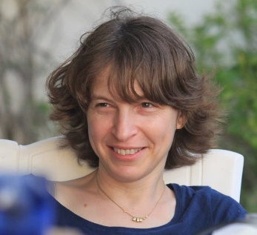
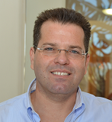
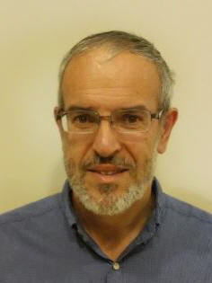
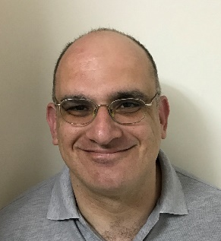
WatchIT: Who Watches Your IT Guy?
Noam Shalev Technion
Idit Keidar Technion
Yaron Weinsberg IBM Research
Yosef Moatti IBM Research
Elad Ben-Yehuda IBM Research
SOSP 2017, October 31, Shanghai, China.

Slide 2
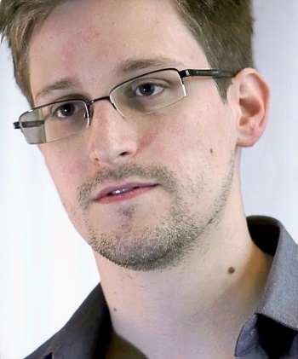
Motivation
“God, root, what’s the difference?”
Insider IT can steal valuable data
E.g., Edward Snowden.

Slide 3
Motivation (Based on True Story)
Charlie
Bob
Alice
Deposit | Balance
+10 | 100
-5 | 95
IT Support
Storage Device
Storage Solution Company

Slide 4
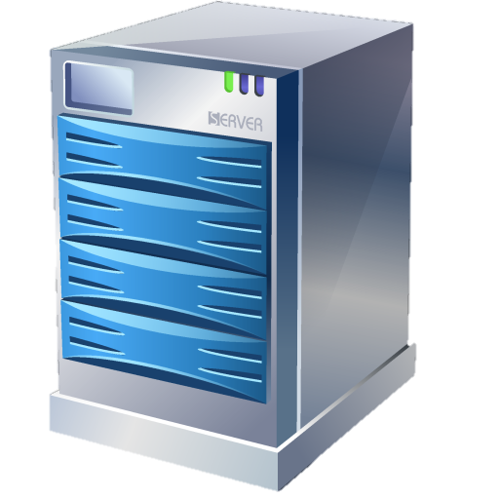
Observation
Documents
Network
Code
Processes
Media
System Files
“My Matlab license has expired.”
System Administrator
IT Department
Select IT specialist
End User

Slide 5
Observation
Documents
Network
/programs/matlab/
Code
Processes
Media
System Files
“My Matlab license has expired.”
System Administrator
IT Department
Select IT specialist
End User

Slide 6
Contributions
Strategy that constrains IT personnel’s view of the system
WatchIT: POC implementation of our strategy
A case study on the IT department of IBM Research, Israel.

Slide 7
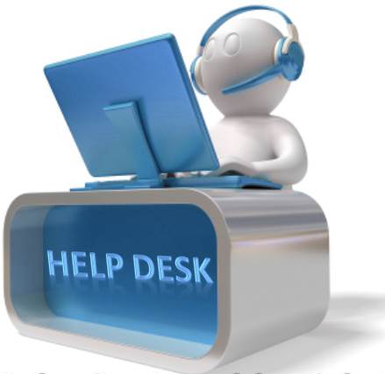
Threat Model
Malicious IT person
Accesses the system only following a trouble ticket submission
Can access any resource in view
Trusted Computing Base (TCB)
System hardware, OS, drivers, services
E.g., Microsoft BitLocker.

Slide 8
Background – Linux Containers
Provide lightweight virtualization
Shared OS kernel
Less overhead than VM
Isolation that resembles a VM
Employ namespaces
File-System
Network
Process IDs
Users
Inter-Process Communication
Time-Sharing

Slide 9
Background – Linux Containers
Provide lightweight virtualization
Shared OS kernel
Less overhead then VM
Host
(lnx-host)
Container
(lnx-cont)
gcc
java
etc/
home/
usr/
var/
conFS/
progs/
etc/
home/
usr/
var/
proc/
init
bash
77.139.180.15
/
77.139.180.14

Slide 10
Key Idea
Exploit the isolation of Linux containers
Punch this isolation
Create a new container type
Confine system administrators in punched containers
System Administrator

Slide 11
Key Idea
Exploit the isolation of Linux containers
Key advantages
Compartmentalize system administrator
Retain superuser privileges
System Administrator

Slide 12
Introducing Perforated Container
Like Linux container
Shares some resources with the host
Example
Host
(lnx-host)
Host
(lnx-host)
Traditional Container
(lnx-cont)
Perforated Container
(lnx-pcont)
etc/
home/
usr/
var/
conFS/
progs/
etc/
home/
usr/
var/
proc/
bash
etc/
home/
usr/
var/
conFS/
progs/
etc/
home/
usr/
var/
proc/
bash
gcc
java
gcc
java
init
init
77.139.180.15
77.139.180.14
/
77.139.180.14
/
Traditional Container Perforated Container

Slide 13
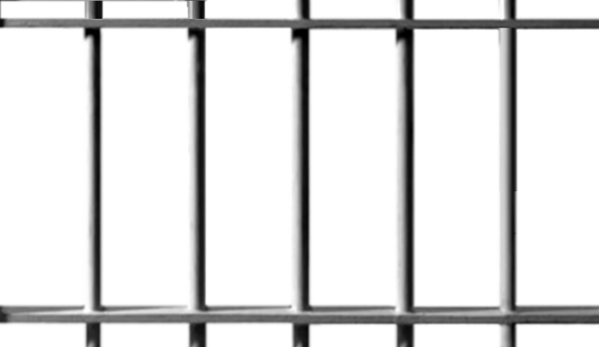
Introducing Perforated Container
Like Linux container
Shares some resources with the host
Shared resources are determined by prediction
For each trouble ticket
Custom tailoring
The administrator is still a god
But only within the p.container limits.

Slide 14
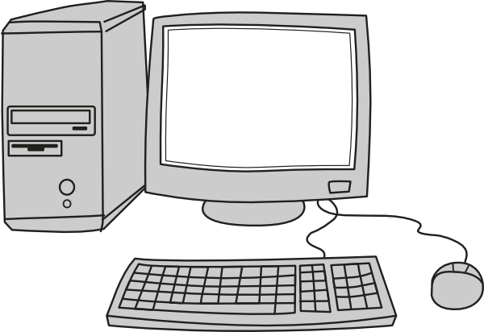
Deployment Example
“My Matlab license has expired.”
This is a Maltab license issue
- Network: License Server
- Filesystem: Matlab files
User Machine
Ticket
Predict Isolation
Configure P.Container
Deploy
>/matlab/
License Server
Netbatch Servers
Software Repository
Organizational Shared Storage

Slide 15
Perforated Container as a Sandbox
Turn perforated container into a sandbox for administration
Monitor the information that streams through the holes
Network traffic
Filesystem operations
How?
Network – existing solutions
Filesystem – a new filesystem, ITFS.
FS

Slide 16
Filesystem Monitor –
FS
Introducing a new filesystem – ITFS
Out of the box deployment
Monitors all file operations
Operates by policy
Trap file system calls
Examine the call
Examine the target file
Consult policy manager
P. Container
Host
open()
Policy Manager
Financial Records?
ITFS
Userspace
Kernelspace
FUSE
Ext4

Slide 17
ContainIT Software Architecture
UTS NS
IPC NS
Policy Manager
Perforated Container
UID NS
Terminal
it@host> _
PID NS
NET NS
MNT NS
Network Monitor
Filesystem Monitor
Host
Resources
Network
Filesystem
Processes
Hostname

Slide 18
One More Thing…
What if the perforated container limits are too restrictive?
What if the prediction is wrong?

Slide 19
Introducing Permission Broker
Host
Combine with a Permission Broker
Service installed on the host
Executes operations on behalf of the perforated container
Logs and monitors all operations
Can change the view of the perforated container
Policy dictated
Permission Broker
Process Tree
File-System
Network

Slide 20
ContainIT Software Architecture
UTS NS
IPC NS
Policy Manager
Perforated Container
UID NS
Terminal
Host namespaces
it@host> _
PID NS
NET NS
MNT NS
Permission Broker
Network Monitor
Filesystem Monitor
Host
Resources
Network
Filesystem
Processes
Hostname

Slide 21
See the Paper For…
Threat analysis
Security measures
Circumventing WatchIT
Exclusion (XCL) namespace
Filesystem rerouting & evaluation
On-line filesystem view adjustments
Real world deployment implications

Slide 22
Case Study & Evaluation

Slide 23
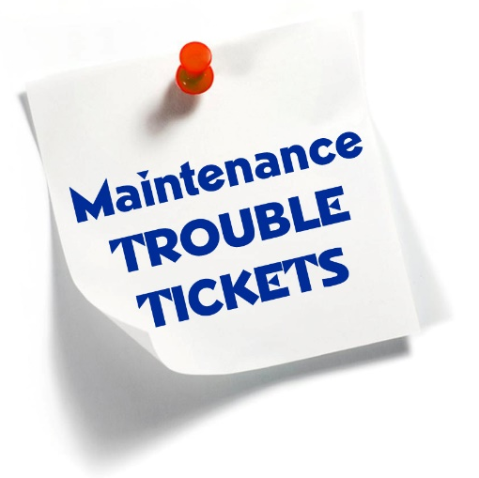
Environment
IT department of IBM Research, Israel
~64,000 user reported trouble tickets
~16,000 Linux related
Free text
Unclassified
Goal: prove WatchIT feasibility
Effective isolation
Low usage rate of permission broker

Slide 24
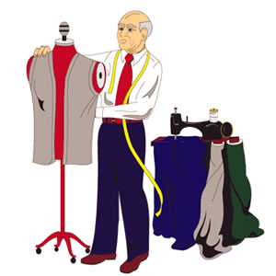
Methodology
Three stages:
Database analysis
Based on previously reported tickets (~7 years)
Custom Tailoring
Test period
Based on newly arrived tickets (~3 months)

Slide 25
Stage 1 – Database Analysis
Clustering using ML for topic extraction
Latent Dirichlet Allocation (LDA) [Blei et al.]
Preprocessing
Word stemming
Stop word removal
Non-informative word removal
Obfuscation of addresses, server & project names.

Slide 26
Stage 1 – Database Analysis
Clustering using ML for topic extraction
Latent Dirichlet Allocation (LDA) [Blei et al.]
Partial results:
User-Password
Topic T-1 | Topic T-2 | Topic T-5 | Topic T-6 | Topic T-10
license | password | work | install | access
matlab | user | time | < server > | user
error | connect | machine | version | add
DB2 | account | slow | < OS > | group
toolbox | login | stuck | upgrade | team
message | locked | reboot | < application > | permission
License Related
Slow Server
Software Related
Permissions

Slide 27
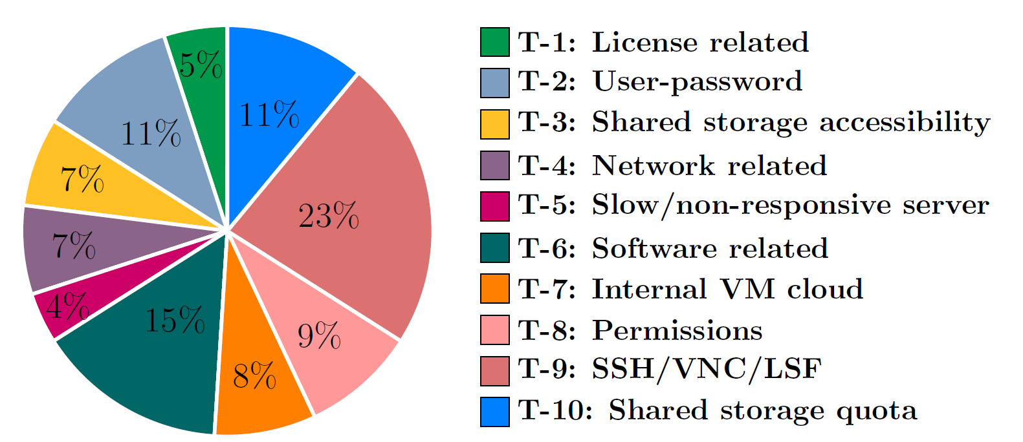
Stage 1 – Database Analysis
Dataset distribution
~16,000 Linux trouble tickets
Classifier results

Slide 28
Stage 2 – Custom Tailoring
File System
Network
View Topic | Process View | Root Directory | Home Directory | /etc/ | License Server | Target Machine
License
Slow Server
VNC
Topic

Slide 29
Stage 3 – Test Period
Three month test period (Dec 16’ to Feb 17’)
~400 tickets
For each ticket
Classify
Record the used permissions
Check whether the permission broker was needed

Slide 30
Stage 3 – Test Period Results

Slide 31
Stage 3 – Test Period Results
Overall - 92% satisfaction
Did not use the permission broker
8% usage rate of permission broker
1% for process view
7% for networking

Slide 32
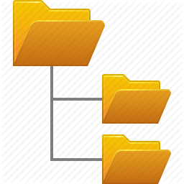
Stage 3 – Test Period Results
Achieved isolation:
Network isolated in 98% of tickets
WWW access was given only in 32% of cases
Only to whitelisted websites
Filesystem isolated in 62% of tickets
100% monitored by ITFS
Processes isolated in 36% of tickets

Slide 33
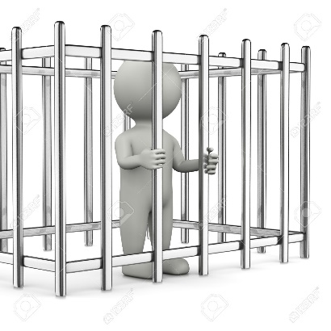
Conclusions
We introduce the perforated container abstraction
Sandbox for administration tasks
Case study shows that WatchIT approach is feasible
WatchIT raises the bar for a malicious IT insider

Slide 34
Thank You!
WatchIT: Who Watches Your IT Guy?
Noam Shalev Idit Keidar Yaron Weinsberg Yosef Moatti Elad Ben-Yehuda
noams@technion.ac.il
UTS NS
IPC NS
UID NS
Policy Manager
Host
PID NS
Predict Isolation
Configure P.Container
>/matlab/
NET NS
MNT NS
FS
Netbatch Servers
Software Repository
Organizational Shared Storage
Host
Resources
Network
Filesystem

